Slide 1
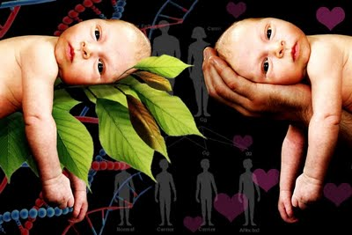
Nature Vs. Nurture
Tutorial Week VII
HUL261 – Introduction to Psychology

Slide 2
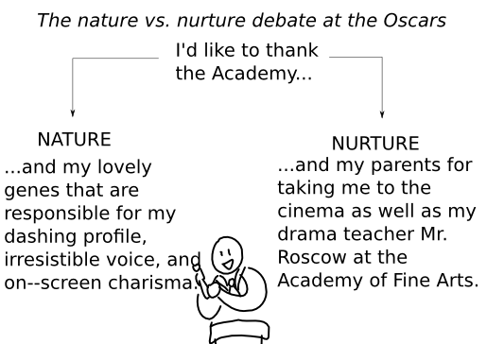
The Debate
For years, the nature vs. nurture debate has been an issue in psychology.
The debate is how genetic inheritance and environmental factors play in a person’s development and characteristics and which one plays a bigger role

Slide 3
What does “Nature” Mean?
Nature refers to an individual’s qualities based on their genes
Physical traits
Personality traits
Etc.
These traits stay the same regardless of where you were born and raised

Slide 4
Examples of Nature
A girl was born with brown hair because her parent’s hair was brown too.
Therefore; her brown hair was inherited
Genetic diseases
Eye color
Hair color
Skin color
Height

Slide 5
What does “Nurture” Mean?
“Nurture refers to all environmental influences after conception, i.e. experience.”
In other words
What an individual learns by its surroundings and experiences

Slide 6
Examples of nurture
Suppose a man had parents who both consumed drugs on a daily basis, and their son began to use drugs as he got older
This may have been a result of “nurture”
Because; he was around this type of environment and this is what he learned
A child might observe and be taught how to be polite by saying “please” and “thank you”

Slide 7
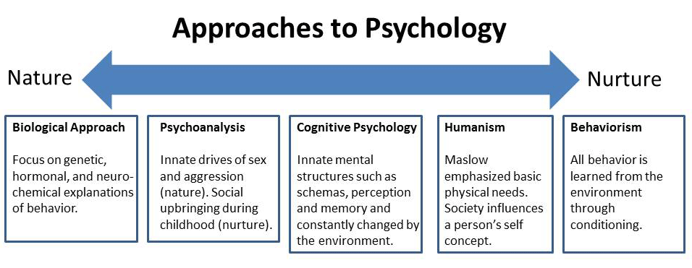

Slide 8
Vocabulary
Behavioral Genetics: The science of how genes and environments work together to influence behavior
quantitative genetics: The scientific discipline in which similarities among individuals are analyzed based on how biologically related they are.
heritability coefficients: Measures how strongly differences among individuals are related to differences among their genes. Varying from 0 to 1, it is meant to provide a single measure of genetics’ influence of a trait.
Adoption Studies: A behavior genetic research method that involves comparison of adopted children to their adoptive and biological parents.
Twin studies: A behavior genetic research method that involves comparison of the similarity of identical (monozygotic; MZ) and fraternal (dizygotic; DZ) twins.

Slide 9
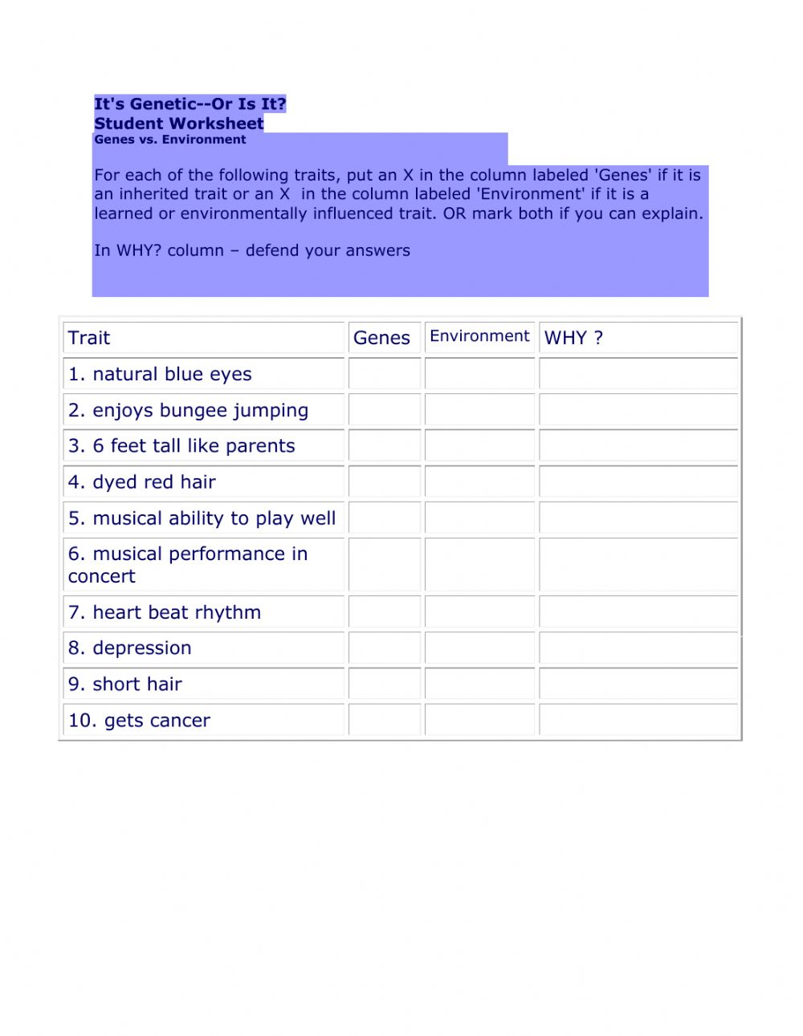
EXERCISE

Slide 10
discussion
Is your personality more like one of your parents than the other? If you have a sibling, is his or her personality like yours? In your family, how did these similarities and differences develop? What do you think caused them?
Can you think of a human characteristic for which genetic differences would play almost no role? Defend your choice.
Do you think the time will come when we will be able to predict almost everything about someone by examining their DNA on the day they are born?
Identical twins are more similar than fraternal twins for the trait of aggressiveness, as well as for criminal behavior. Do these facts have implications for the courtroom? If it can be shown that a violent criminal had violent parents, should it make a difference in culpability or sentencing?

Slide 11
conclusion
Is Human Behavior affected by nature or nurture?
Nature and Nurture both play a role in a person’s traits, they both operate together and somewhat to an equal extend.
For example
Many families have genetics that gives them a great advantage in musical, mathematical, or verbal intelligences
However, this does not mean that you will have these advantages if you do not practice them.
If you are raised in a home with no sign of music, math, or verbal communication you will not develop these advantages since you are not exposed to them.
It simply demonstrates that you have a genetic possibility for being outstanding in these areas.
There is no telling whether If nature or nurture takes a bigger role in a persons life. Without either of them, a person would not be the way they are.

Slide 12
Thank You
Media
http://www.youtube.com/watch?v=Wd5Y3-F79LY
References
http://psychology.about.com/od/nindex/g/nature-nurture.htm
http://www.diffen.com/difference/Nature_vs_Nurture
http://www.simplypsychology.org/naturevsnurture.html
http://curiosity.discovery.com/question/understanding-nature-nurture-twins
http://www.scpr.org/programs/airtalk/2012/07/18/27453/how-twins-separated-at-birth-inform-the-nature-ver/

